Slide 1
Traffic Example
April 2017

Slide 2
Purpose
Determine if we can distinguish low- versus high-traffic photos from social media (Flikr) to support patterns of life use case

Slide 3
Approach
Collected images from Flikr
Data set included approximately 1800 “low-traffic” and 300 “high-traffic” images
Used transfer learning approach from VGG-16 model (trained in ImageNet) that we are using for other use cases

Slide 4
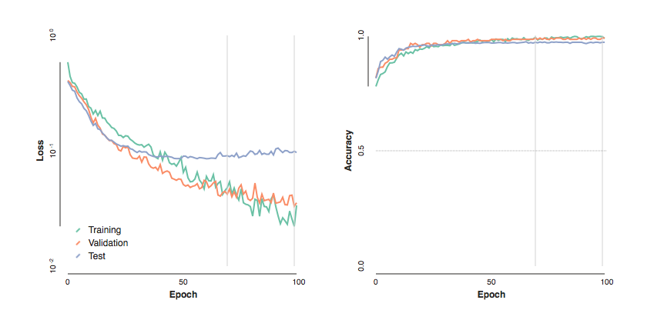
Results
1741 images, 1405 labelled “low-traffic”, 336 labelled “high-traffic”,
Divided into 696 training images, 174 validation images, and 871 test images.
After fine-tuning a VGG-16 model pre-trained using ImageNet, performance was:
99.1% training accuracy
98.9% validation accuracy
97.0% test accuracy

Slide 5
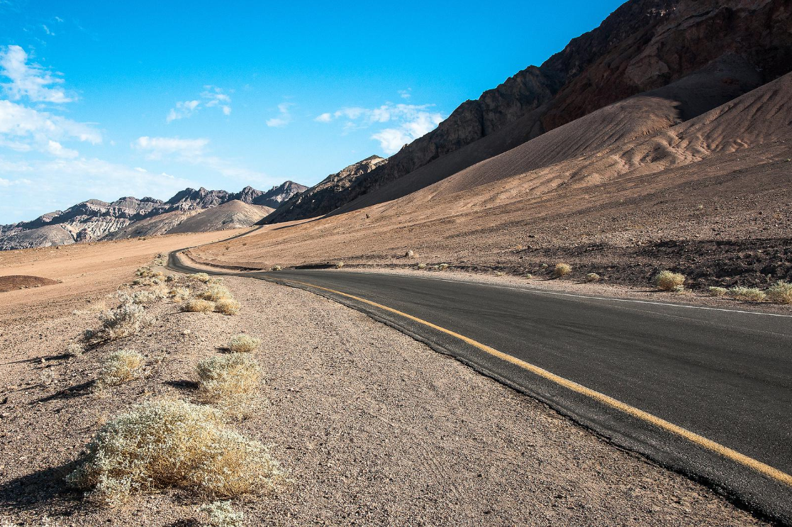
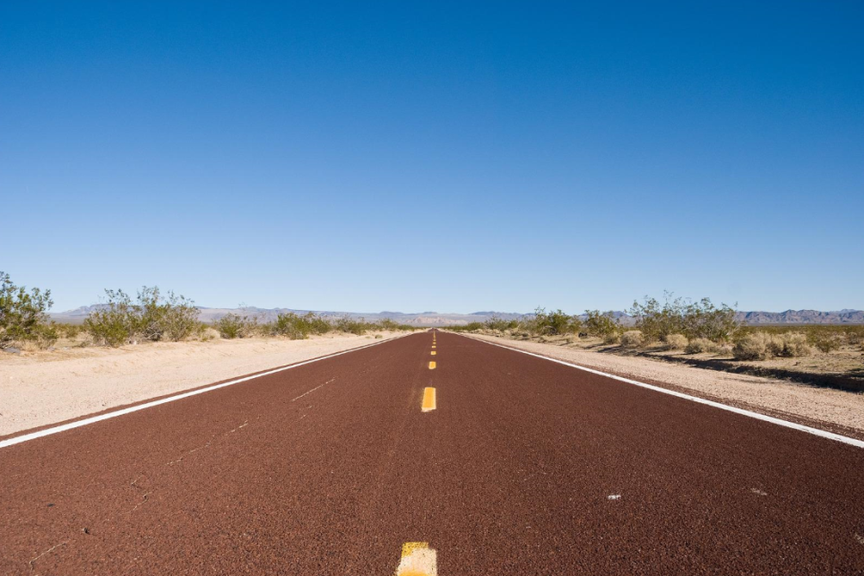
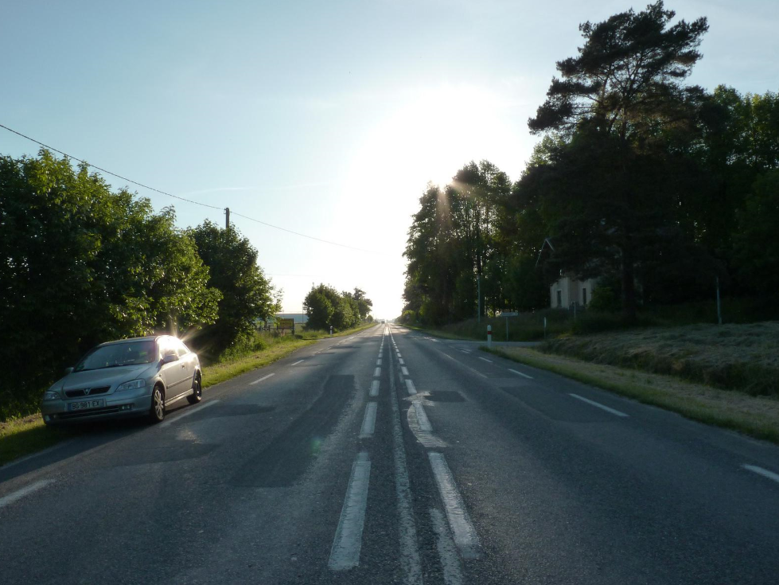
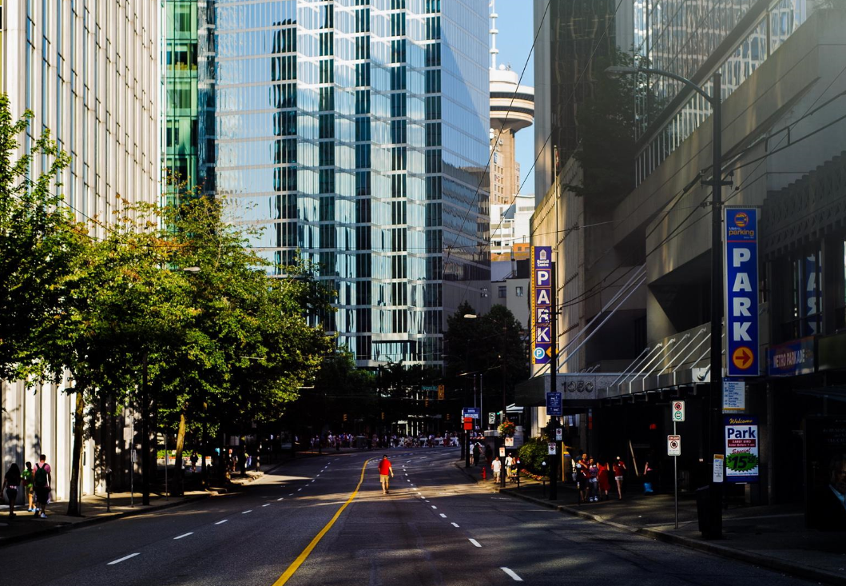
Example “Low-Traffic” Photos
Notes:
May contain some, but usually not more than 3-4, vehicles
Includes city/urban streets, and lots of desert highways

Slide 6
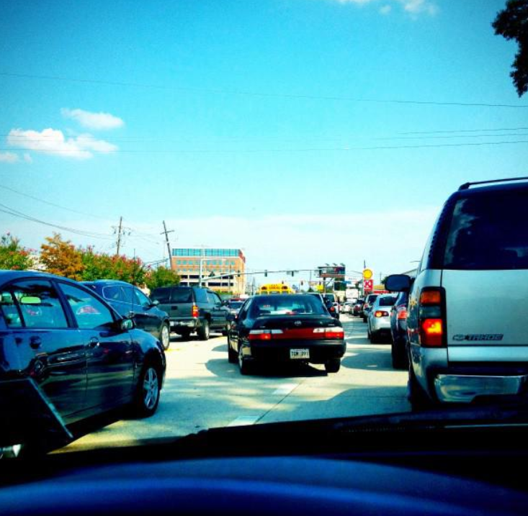
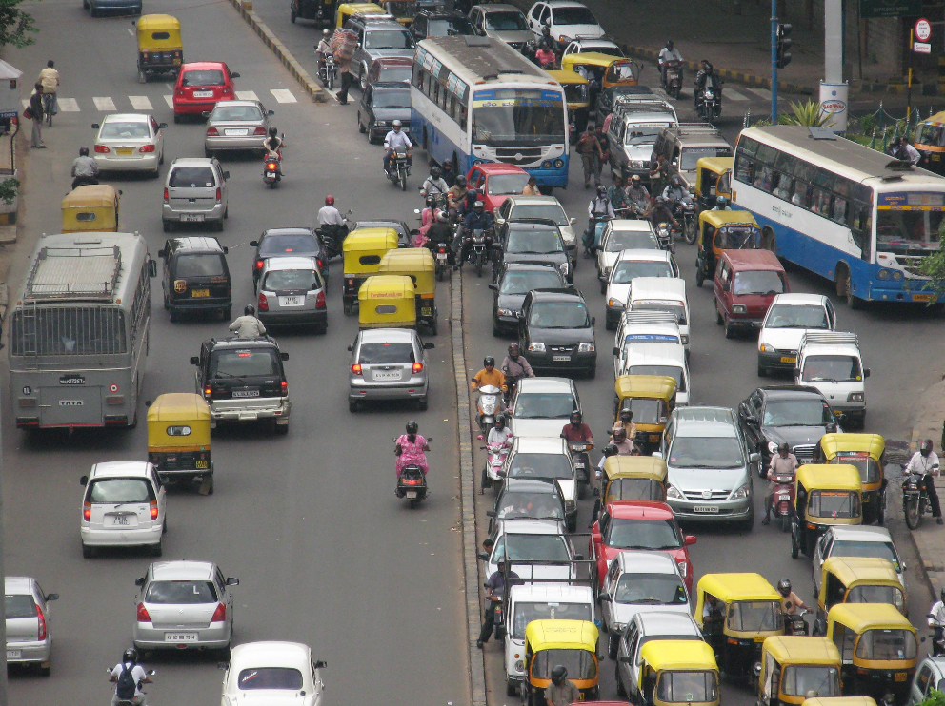
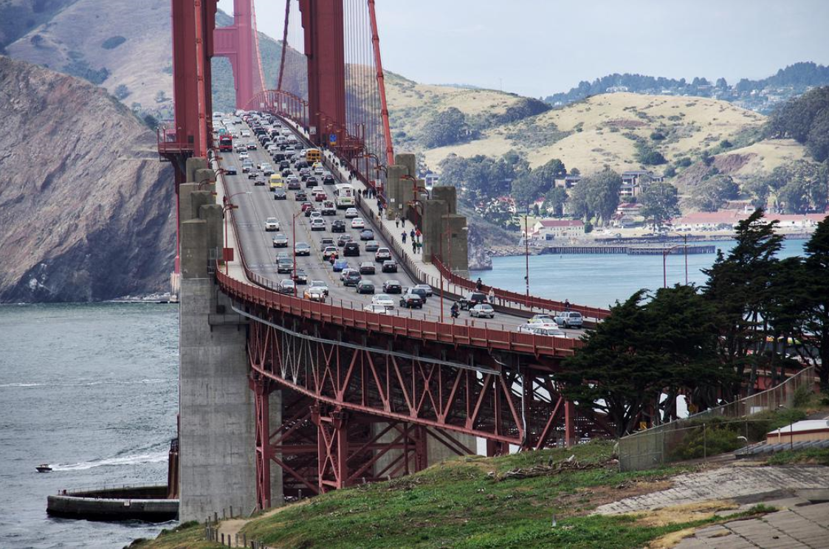
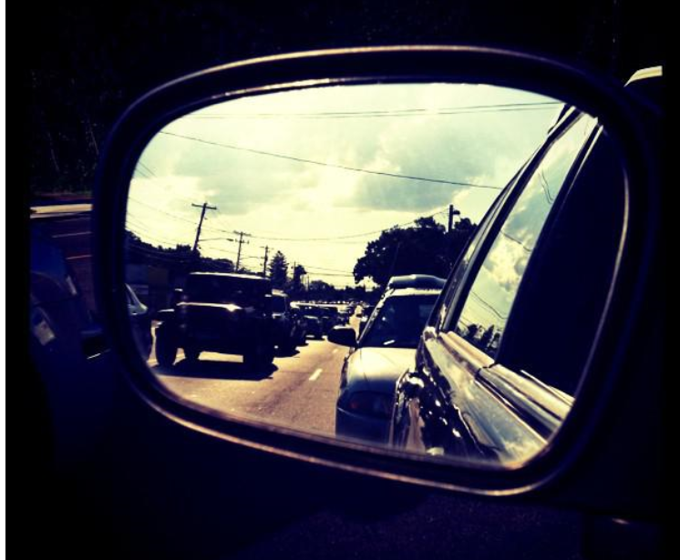
Example “High-Traffic” Photos
Notes:
Includes: Mostly urban settings, perspectives ranging from driver/passenger viewpoints (over-the-dash, rear-view mirror shots) to broader traffic vistas
Explicitly excluded the classic night shot with streaming red/white lights (since you can’t see the cars, or how many there really are) and moped-only traffic for this example.

Slide 7
Caveats/Disclaimers
The VGG-16 model was trained on ImageNet, which already includes vehicles. So it makes sense that our results on this initial model are pretty good.
Anecdotally, the low-traffic and high-traffic photos look very different: low-traffic have lots of desert scenes, windy roads and lots of perspective photos in which road markings (yellow and white lines down the center, etc.) are highly visible; high-traffic have lots of red lights, almost exclusively urban, and are more dense with objects. So, it’s possible that even though we can distinguish between high- and low-traffic from this data set, if the model has learned factors that are biased to this image set and might not generalize well.

